Slide 1
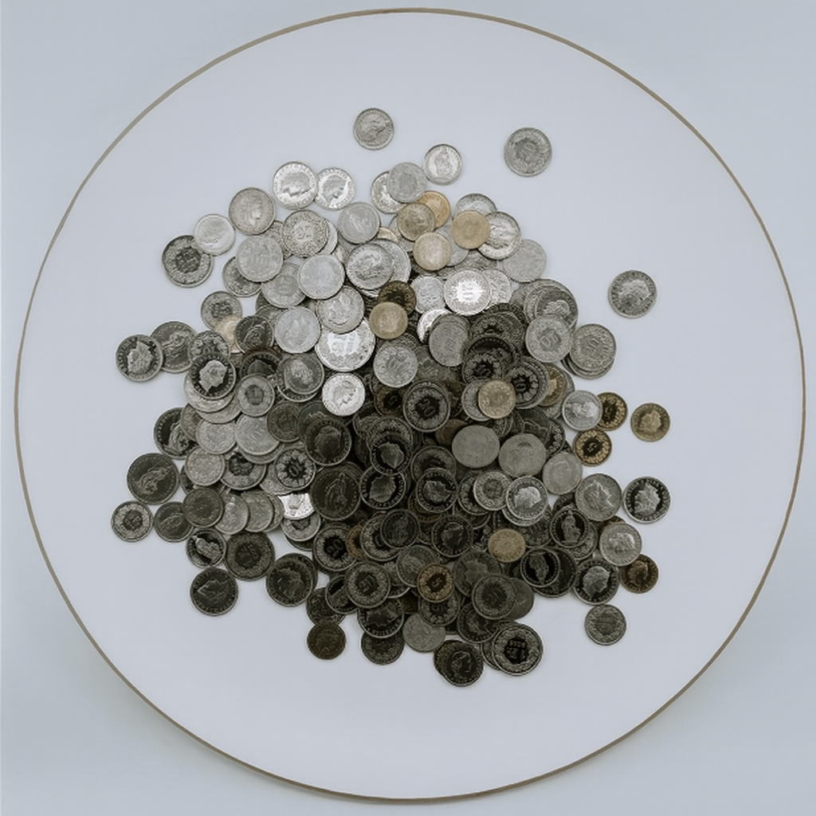
Unlocking Kickstarter Crowdfunding
Success
A data-driven analysis of Kickstarter performance and key
success.
GROUP 4
Jay Darji
Shereena M
Shaik Apsana
Konuru Lalitha
Veena Lsareddy
Dabbugunta Saisree

Slide 2



Presentation Agenda
📊 Data Overview
🎯 Objectives: KPIs
⚙️ Process
🔎 Analysis
💡 Recommendations and Insights
📝 Conclusion
🚧 Challenges & Learnings
🖼️ Picture Dashboard/Report

Slide 3


📊 Crowfunding : Data Overview
Examining the scale and success rates of the platform, highlighting the competitive environment and potential reward.
365.89K
38.35%
39.97M
Total Projects Launched
Overall Success Rate
Total Numbers of Backers
Total volume of campaigns across all categories since inception.
The percentage of projects that successfully met their funding goal.
The cumulative number of unique individuals who have contributed.
80.36
$3.46B
Average Days of
Successful project
Total Money Raised
The average duration of successful project reflects the community’s sustained engagement and commitment to creative goals
The significant capital flowed through the platform by the community.

Slide 4
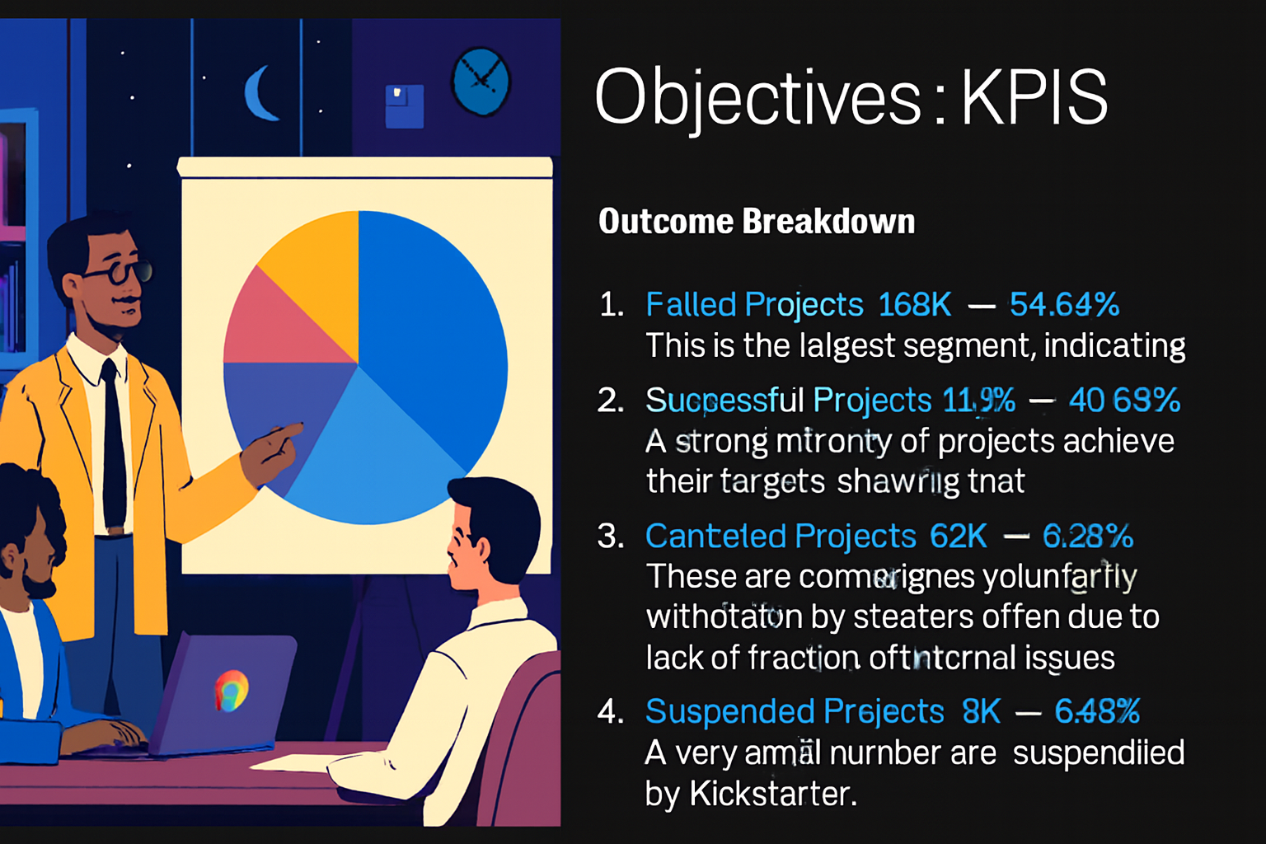
🎯 Objectives : KPIS
Outcome Breakdown
Failed Projects: 188K — 54.54% This is the largest segment, indicating that most campaigns do not reach their funding goals.
Successful Projects: 140K — 40.63% A strong minority of projects achieve their targets, showing that success is possible with the right strategy.
Canceled Projects: 32K — 9.28% These are campaigns voluntarily withdrawn by creators, often due to lack of traction or internal issues.
Suspended Projects: 3K — 0.86% A very small number are suspended by Kickstarter, typically for violating platform rules.
Location Breakdown
United States: 288K projects — Dominates the platform with the highest volume of campaigns.
Great Britain : 83K projects — Significant but far behind the US.
Canada: 15K projects — Moderate activity.
Remaining Countries: Mostly below 10K projects — Minimal contribution to overall volume.

Slide 5
🎯 Objectives : KPIS
Category Breakdown
Top Categories: Product Design (23.2K), Tabletop Games (15.6K), Music & Documentary (15.1K, 14.1K) — Popular for creativity and community appeal.
Mid-Tier: (10K–8K) - Video Games, Shorts, Food, Film & Video; Art, Fiction, Nonfiction, Apparel (~7K).
Lower-Tier: Mostly under 5K projects — Tech, Publishing, Business, Indie Rock, Photography, Web, Comics, Crafts.
Year Based Outcome
Highest: 2014 – 59K projects — Peak year for project creation
Mid Range: 2012–2017 – 39K to 58K projects — Stable growth and strong activity
Lowest: 2009 – 1K projects and 2019 – 4K projects — Early launch and sharp decline

Slide 6





⚙️ Process Workflow
Data Cleaning:
Removed duplicates, mapped outcomes
Mastered Power Query for handling messy datasets
Database Management & SQL:
Skilled in managing high-volume data efficiently using MySQL
Experienced in crafting advanced SQL queries to derive performance metrics and actionable insights
Dashboard Design:
Built interactive dashboards in Excel , Tableau and Power BI
Learned to select the right charts for trends, comparisons, and KPIs
Project Management Skills:
Executed end-to-end workflow: Raw Data → Cleaned Data → SQL Analysis → Dashboards → Insights
Developed a strong understanding of the value of clear documentation and impactful data storytelling.

Slide 7
Success Rate by Goal Range
Goals Under $1K: ~60% Success Rate
Goals $1K - $10K: Moderate Success Rate
Goals $10K - $100K: Significant Drop
Goals Over $500K: Success Rate Drops Below 10%
🔎 Analysis

Slide 8
💡 Recommendations and 🔍 Insights
🎯 1. Set Realistic Funding Goals
Projects with goals under $1K have a ~60% success rate
Success rate drops below 10% for goals over $500K
Recommendation: Aim for modest, achievable goals unless backed by strong marketing and community support
🧩 2. Choose High-Performing Categories
Top success rates: Outdoors (76.5%), Residences (73.7%), Animals, Indie Rock, Classical
📅 3. Launch Timing Is Flexible
Monthly and quarterly data show consistent project creation
No strong seasonal spikes
Recommendation: Focus on campaign readiness and audience prep rather than timing
🔍 Insights
📈 1.Kickstarter Peaked in 2014
Project creation peaked at 59K in 2014, then declined to 4K by 2019
Indicates platform maturity and increased competition
🌍 2.US Dominates, but Global Potential Exists
28K projects from the US vs 9K from Great Britain, 3K from Canada
Other countries contribute <1K — untapped potential for global creators
📊 3.Outcome Breakdown
Failed projects: 54.5%
Funded projects: 39.4%
Canceled/Suspended: ~5% combined
Insight: Most projects fail — success requires strategic planning, realistic goals, and audience targeting
🧠 4.Success Is Strategy-Driven Success isn’t random — it correlates with goal size, category choice, and audience targeting.

Slide 9
📝 Conclusion: Actionable Strategies for Launch
The data indicates a mature but competitive crowdfunding platform with strong overall activity and significant capital flow, despite a recent
decline in new projects.
Overall Platform Health:
The platform has generated substantial activity with 365.89K Total Projects Launched and $3.46B Total Money Raised, demonstrating
its potential to fund creative.
It has a broad community, attracting nearly 40 million unique individuals (Backers).
Key Success Indicators:
The Overall Success Rate is 38.35%, with a strong minority of projects (40.63%) succeeding, suggesting a path to funding when
managed correctly. Successful projects are completed relatively quickly, with an Average of 80.36 Days.
Strategic Categories and Goals:
Top Categories like Chiptune and Residencies exhibit the highest volumes and best success rates(76.32% and 73.97%
respectively),indicating where creator and backer interest is strongest.
Projects with smaller funding goals (under $1K) have the highest success rates (~60%), confirming that modest,
achievable targets are the most effective strategy.
Market Dominance:
The United States dominates the platform, accounting for the highest volume of campaigns (288K projects).
Great Britain The second-largest contributor to project volume on the platform.

Slide 10

🚧Challenges & Learning
Large Data Volume:
Excel and direct imports struggled; had to design scalable ingestion methods.
Size : 3,65,892 records, 25+ attributes. (id, name, goal, pledged, category, backers, dates…).
Dataset contained hundreds of thousands of rows, too large for manual handling.
Data Loading into MySQL:
Faced multiple technical errors:
Row errors due to mismatched column counts.
Incorrect decimal value errors (currency symbols inside numeric columns).
Date parsing errors because of mixed formats.
Set Realistic Funding Goals:
The most critical learning is to set achievable, lower funding goals
(ideally under $1K) to maximize the chance of success. A project should aim to secure its
minimum funding first, rather than an optimal target.
Different Tool Requirements:
Each tool (Excel, Power BI, Tableau, MySQL) had its own limitations and formatting needs.
Had to repeatedly adapt and restructure the dataset to fit Excel pivot models, Tableau extracts,
and Power BI model relationships.
Time-Intensive Cleaning:
Cleaning and standardizing the dataset (especially for dates, goals, pledged amounts, and
backers) took more time than analysis.
Learned the importance of data preprocessing before visualization.

Slide 11
